Slide 1

Customer Shopping Behavior Analysis
Analyzing 3,900 transactional records to uncover key insights into customer spending, preferences, and subscription behavior.
Notes:
1

Slide 2
Project Overview & Data Summary
Project Goal
Dataset Snapshot
Uncover insights from 3,900 purchases to guide strategic business decisions.
3,900
18
Focus on spending patterns, customer segments, product preferences, and subscription behavior.
Rows
Columns
Total purchases analyzed
Features including demographics, purchase details, and behavior.
37
Missing
Values in Review Rating column.
Notes:
2

Slide 3





Exploratory Data Analysis: Python Workflow
Initial data preparation and cleaning steps using Python (pandas).
Data Loading
Imported dataset using pandas.
Initial Exploration
Checked structure (.info) and summary statistics (.describe).
Missing Data
Imputed Review Rating using median by product category.
Feature Engineering
Created age_group and purchase_frequency_days.
Notes:
3

Slide 4

Data Consistency and Integration
Standardization
Database Connection
Renamed columns to snake_case for readability.
Connected Python script to PostgreSQL.
Dropped redundant promo_code_used column.
Loaded cleaned DataFrame for structured SQL analysis.
Notes:
4

Slide 5



Key Business Insights: Revenue & Spending
Revenue by Gender
Shipping Type Spend
Top Revenue Age Group
Male revenue: $157,890
Express Avg. Spend: $60.48
Young Adult: $62,143
Female revenue: $75,191
Standard Avg. Spend: $58.46
Senior: $55,763
839 customers used discounts but still spent above the average purchase amount.
Notes:
5

Slide 6

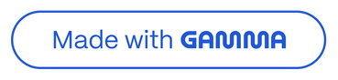
Product Performance & Preferences
Top 5 Products by Rating
Discount-Dependent Products
Gloves (3.86)
Sandals (3.84)
Products with highest percentage of discounted purchases:
Boots (3.82)
Hat (3.80)
Hat (50.00%)
Skirt (3.78)
Sneakers (49.66%)
Coat (49.07%)
Notes:
6

Slide 7



Customer Segmentation
Customers classified based on purchase history.
Loyal
1
3,116 Customers
2
Returning
701 Customers
3
New
83 Customers
Notes:
7

Slide 8


Subscription Analysis
1053
2847
Subscribers (Yes)
Non-Subscribers (No)
Avg. Spend: $59.49
Avg. Spend: $59.87
Total Revenue: $62,645
Total Revenue: $170,436
Repeat Buyers (>5 purchases): 958 are subscribers, 2,518 are not.
Notes:
8

Slide 9
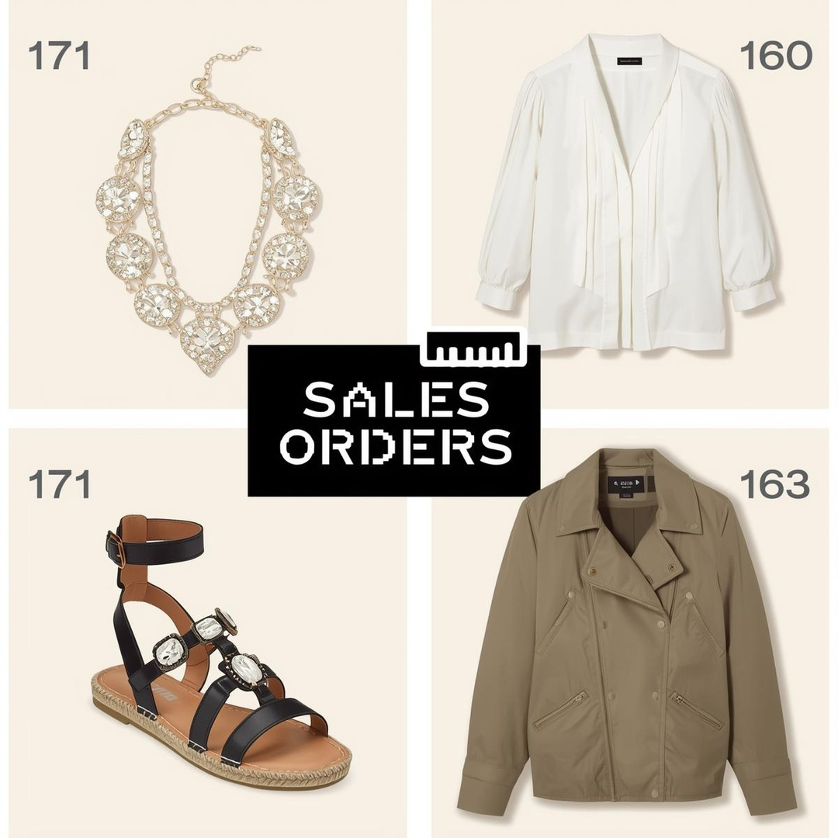
Top Products by Category
Examples of top-ranked items:
Accessories: Jewelry (171 orders)
Clothing: Blouse (171 orders)
Footwear: Sandals (160 orders)
Outerwear: Jacket (163 orders)
Notes:
9

Slide 10
Strategic Business Recommendations
Boost Subscriptions
Loyalty Programs
Promote exclusive benefits to increase subscriber base.
Reward repeat buyers to drive them into the "Loyal" segment.
Targeted Marketing
Product Positioning
Focus campaigns on high-revenue age groups and express-shipping users.
Highlight top-rated and best-selling products in all campaigns.
Notes:
10

